Slide 1
The Determinants of Capital Structure An Empirical Study on Singapore Listed Firms
DSA305 Project Presentation
Yung Qi Yang
Zhang Yuhang

Slide 2
Table of contents
1
4
2
6
Intro & Dataset
Test for Random Effects
5
Pooled OLS
Further Investigation
3
Test for Fixed Effects
Limitation & Conclusion

Slide 3
01
Intro & Dataset

Slide 4
Introduction
The scope of science is incredibly vast and encompasses a wide range of subjects, disciplines, and areas of study. Science seeks to explore, understand, and explain the natural world through systematic observation, experimentation, and the application of rigorous methods. It plays a fundamental role in advancing knowledge, shaping our understanding of the universe, and addressing real-world challenges
Disciplines such as chemistry, physics, biology, astronomy or even recent ones such as computer science contribute to our knowledge and understanding of the world. Science is, simply put, constantly evolving, and interconnected, enabling us to explore and unravel the complexities of our natural world, from understanding the fundamental laws of the universe to getting to know the intricacies of life on Earth and beyond

Slide 5
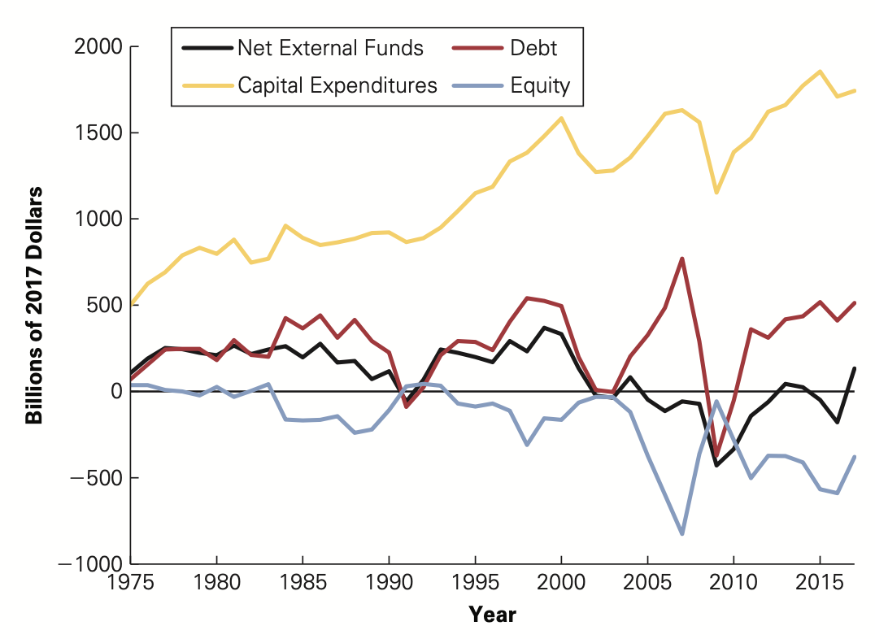
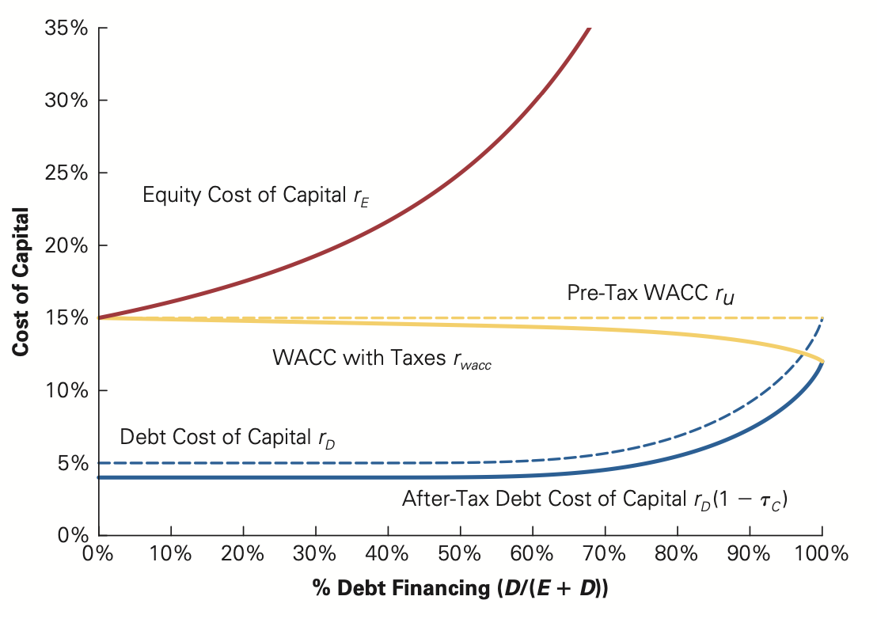
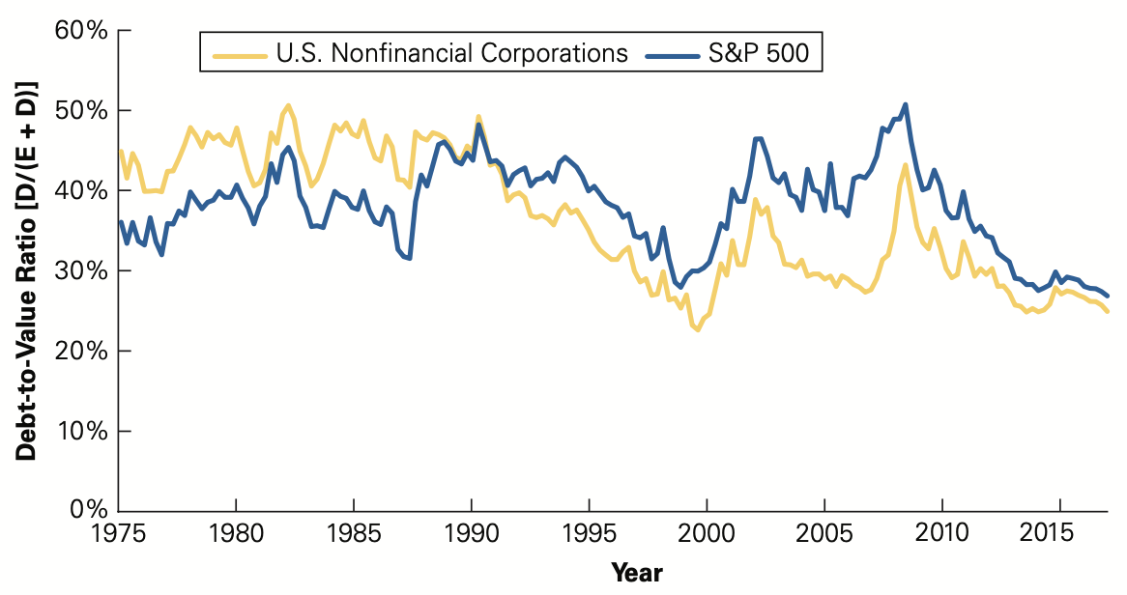
Introduction
Net External Financing and Capital Expenditures by U.S. Corporations, 1975–2017
Debt-to-Value Ratio [D/(E + D)] of U.S. Firms, 1975–2017
The Impact on Cost of Capital
by Capital Structure

Slide 6


Dataset – 605 firms & 20 years
Financial Statement Items
Additional Factors
Balance Sheet
Income Statement
Cashflow Statement
Following IFRS standard
Recalculated for specific variables used in models
Singapore Overnight Rate Average (SORA) as representative for risk-free rate
Consumer Price Index (CPI) as representative for inflation rate

Slide 7
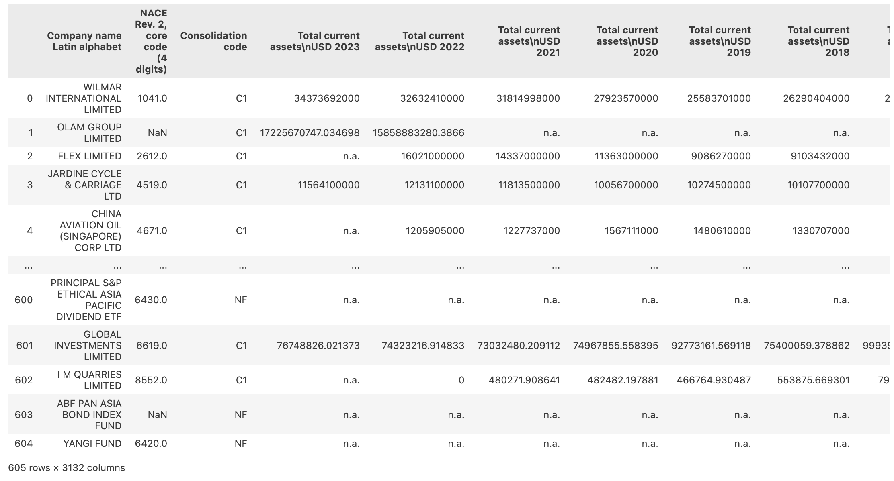
Dataset – reduced to 216 firms & 8 years
Many missing data points
Due to the limitation that different firms might be listed for different duration of years and different disclosure approaches for financial reports
Eliminate all NA data points to maximize the number of observations left

Slide 8
02
Pooled OLS

Slide 9
Variables Selected for the Model
LEVERAGE (Y)
SIZE
PROFITABILITY
Net Debt/Total Assets: Represents the level of leverage, which is indicated by the portion of debt used instead of equity for the firm’s total assets.
Ln(Total Assets): Represents the size of the firm. A larger firm will have a higher intention to finance through borrowing with a lower cost.
EBITDA/TA: Represents the gross earnings of a firm as a portion of total assets. Good profitability represents better cashflow and future growth.
TANG
RISK
LIQUID
Fixed Assets/Total Assets: Represents the tangibility of the assets. A higher tangibility indicates that the firm can liquidate tangible assets in the event of default.
%ΔEBIT/ %ΔNet Sales: Represents the sensitivity of the earnings before interest and tax to the changes in net sales. A stable earnings indicate a better solvency.
Current Assets/Current Liabilities: Represents the liquidity of the firm to pay short-term liabilities using relatively liquid assets.

Slide 10
Variables Selected for the Model
NDTSHIELD
MCAP
FCFF
Non-debt Tax Shield: An indicator that the firm’s savings from the non-debt related items. A higher value showcases a better tax planning.
Market Capitalization: Represents the size of the firm in terms of the market value of equity. A larger firm will have a higher intention to finance through borrowing with a lower cost.
Free Cash Flow for Firm: The cashflow from operating activities after the deduction of non-cash charges and investment activities. A sufficient free cashflow reduces debt demand.
GROWPOT
SOLV
SORA & CPI
Growth Potential: Represents the price over book value. A higher growth potential may incentivize the firm to borrow more because of its good future perspective.
EBIT/Interest Expense: Represents the scale of earnings can be used to pay interest. A higher interest coverage indicates a large space for the firm to borrow more.
SORA: Introduce the effect brought by the risk-free rate on the firm’s cost of borrowing.
CPI: Introduce the effect brought by inflation regarding to the value of each term of financial statements.

Slide 11
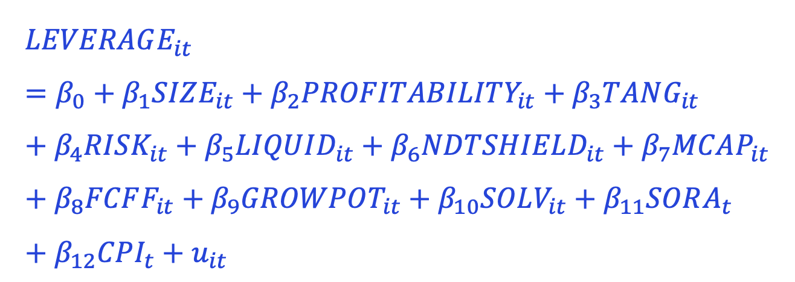
Linear Model for Pooled OLS
$$LEVERAGE_{it}=β_{0}+β_{1}SIZE_{it}+β_{2}PROFITABILITY_{it}+β_{3}TANG_{it}+β_{4}RISK_{it}+β_{5}LIQUID_{it}+β_{6}NDTSHIELD_{it}+β_{7}MCAP_{it}+β_{8}FCFF_{it}+β_{9}GROWPOT_{it}+β_{10}SOLV_{it}+β_{11}SORA_{t}+β_{12}CPI_{t}+u_{it}$$

Slide 12
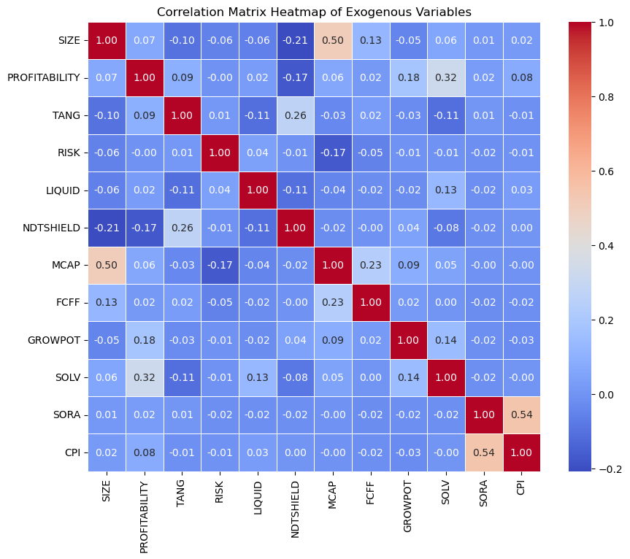
Correlation among Variables
MCAP & SIZE are correlated at 0.50 since they are both the indicators of the company size (in terms of total assets or market value of equity).
SORA & CPI are correlated at 0.54 since, according to macroeconomic theory, interest rate is associated with inflation rate through Philips curve.
No other strong correlation detected.

Slide 13
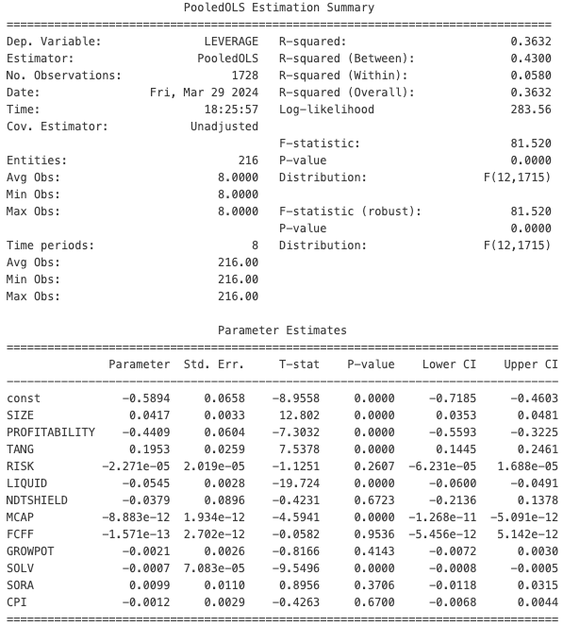
Pooled OLS Result
01
The overall model is highly significant for the joint F-test.
For both non-robust and robust F-statistic, the corresponding p-value are both below 0.0001, implying a good fit at the 99.99% confidence level.
02
Some of the variables are not significant – drop them.
The insignificance can be explained by:
RISK: Not highly significant, might not be a good indicator since it was developed by other paper
NDTSHIED: Tax is not heavy in Singapore, might not be influential enough to SGX firms;
FCFF: Cashflow does not affect leverage decision;
GROWPOT: The SGX firms are not traded as actively as the US market, smaller P/B ratio;
SORA: Risk-free rate increases both equity and debt cost of capital, does not affect leverage decision;
CPI: Similarly, the leverage decision is a ratio, where the price levels are cancelled out.

Slide 14
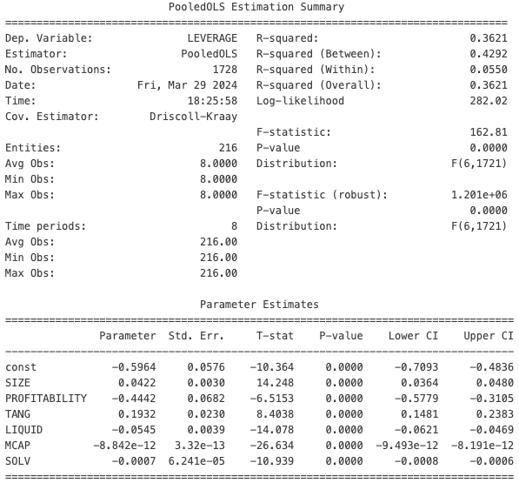
Pooled OLS Result (final ver.)
Pooled OLS without conv_type indicated

Slide 15
Assignment brief
Course | Science
Unit | Introduction to Scientific Inquiry
Project title | Hands-on Exploration: Scientific Method
Tutor | Dr. Tutor
Start date | MM/DD/YYYY
Deadline | MM/DD/YYYY
Abstract of the unit
This unit aims to introduce students to the fundamentals of scientific inquiry, emphasizing the scientific method as a systematic approach to investigating natural phenomena
Assignment brief
In this assignment, students will actively participate in a series of hands-on exercises designed to reinforce the principles of the scientific method. The exercises cover various scientific topics, encouraging students to formulate hypotheses, design experiments, collect data, and draw conclusions

Slide 16
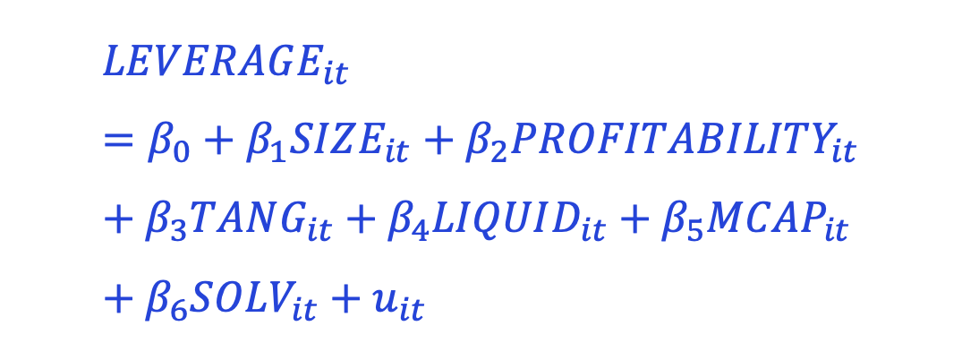
Linear Model for Pooled OLS (final ver.)
$$LEVERAGE_{it}=β_{0}+β_{1}SIZE_{it}+β_{2}PROFITABILITY_{it}+β_{3}TANG_{it}+β_{4}LIQUID_{it}+β_{5}MCAP_{it}+β_{6}SOLV_{it}+u_{it}$$

Slide 17
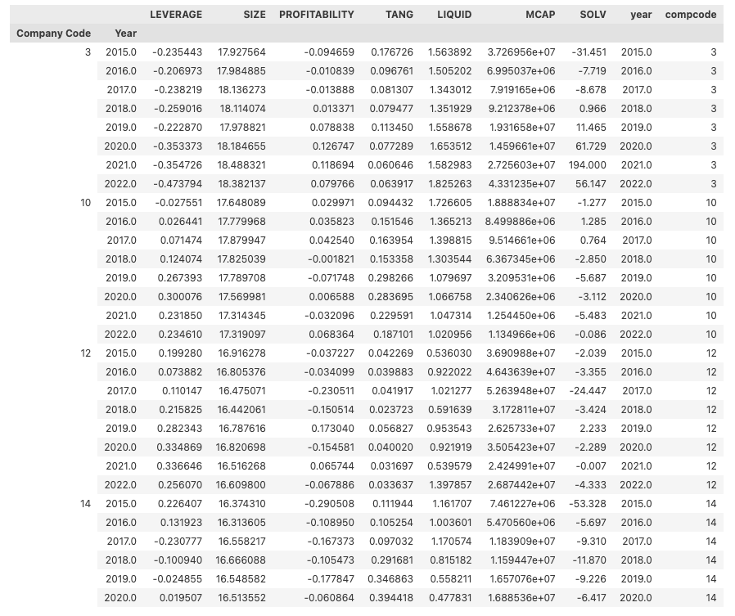
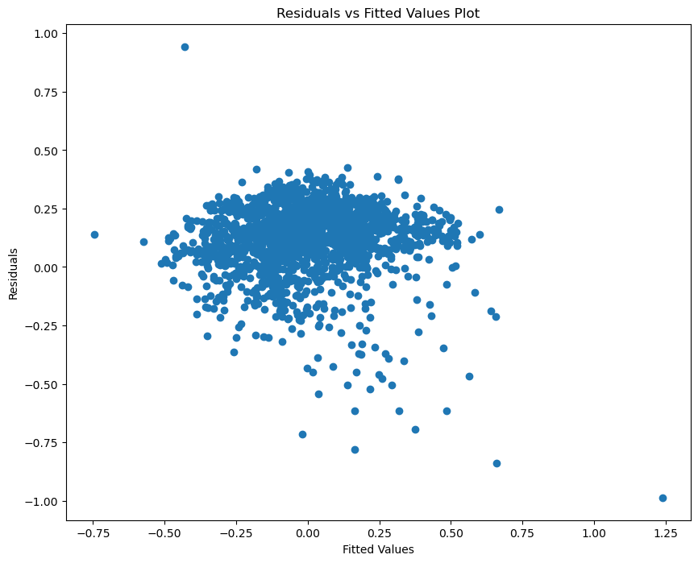
Robust Estimation
Heteroskedasticity
Short Panel
216 entities & 8 years

Slide 18
Robust Estimation
Estimation | F-statistic | P-value | Distribution
Non-robust | 162.81 | <0.0001 | F(6,1721)
Heteroskedastic robust | 113.38 | <0.0001 | F(6,1721)
HAC robust | 1.201e+6 | <0.0001 | F(6,1721)
Clustered robust | 44.533 | <0.0001 | F(6,1721)

Slide 19
Pooled OLS with entity cluster
PooledOLS Estimation Summary
================================================================================
Dep. Variable: LEVERAGE R-squared: 0.3621
Estimator: PooledOLS R-squared (Between): 0.4292
No. Observations: 1728 R-squared (Within): 0.0550
Date: Sun, Mar 31 2024 R-squared (Overall): 0.3621
Time: 18:42:56 Log-likelihood 282.02
Cov. Estimator: Clustered
F-statistic: 162.81
Entities: 216 P-value 0.0000
Avg Obs: 8.0000 Distribution: F(6,1721)
Min Obs: 8.0000
Max Obs: 8.0000 F-statistic (robust): 44.533
P-value 0.0000
Time periods: 8 Distribution: F(6,1721)
Avg Obs: 216.00
Min Obs: 216.00
Max Obs: 216.00
Parameter Estimates
=================================================================================
Parameter Std. Err. T-stat P-value Lower CI Upper CI
---------------------------------------------------------------------------------
const -0.5964 0.1401 -4.2578 0.0000 -0.8712 -0.3217
SIZE 0.0422 0.0068 6.1808 0.0000 0.0288 0.0555
PROFITABILITY -0.4442 0.1056 -4.2075 0.0000 -0.6512 -0.2371
TANG 0.1932 0.0519 3.7260 0.0002 0.0915 0.2949
LIQUID -0.0545 0.0076 -7.1356 0.0000 -0.0695 -0.0395
MCAP -8.842e-12 4.09e-12 -2.1619 0.0308 -1.686e-11 -8.203e-13
SOLV -0.0007 0.0001 -5.0197 0.0000 -0.0009 -0.0004
=================================================================================
Even with entity-cluster robust estimation, the overall F-statistic is highly significant

Slide 20
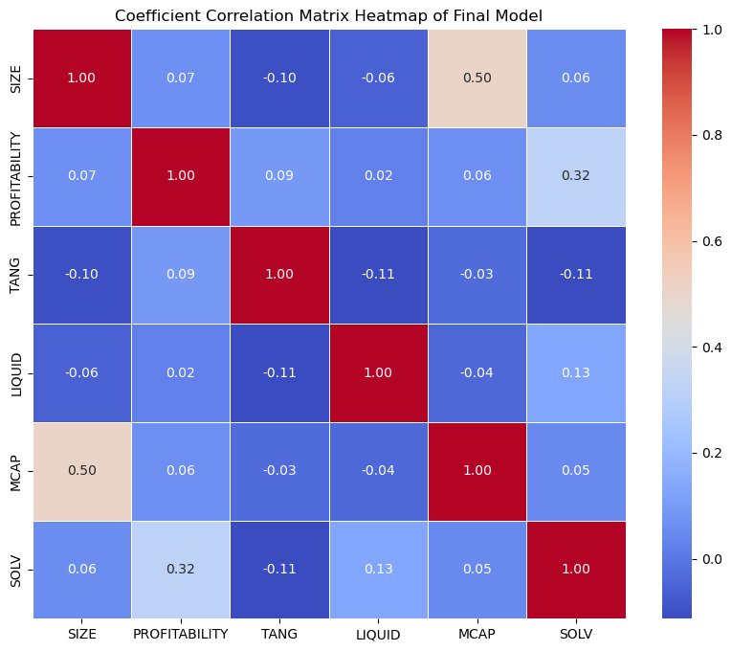
Correlation among Variables (final ver.)
MCAP & SIZE are correlated at 0.50 whilst they are both significant in the Pooled OLS (non-robust) model. Therefore, they will be kept in the model for further investigation.
No other strong correlation detected.

Slide 21
03
Test for Fixed Effects

Slide 22
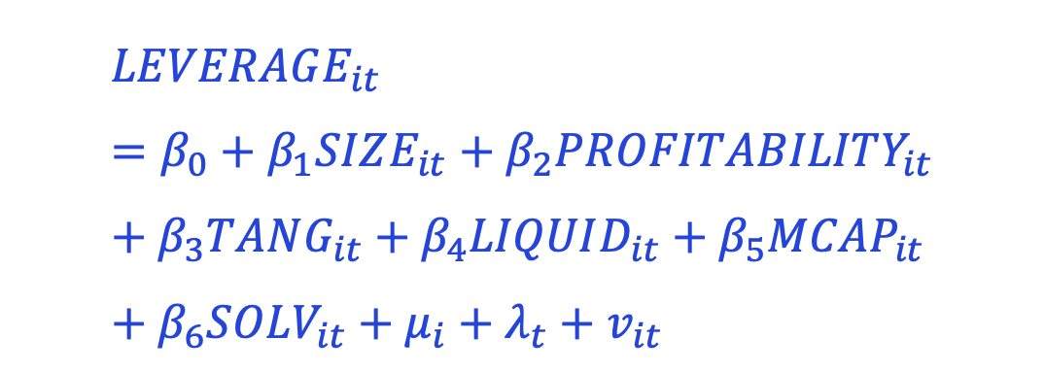
Fixed Effects Model
$$LEVERAGE_{it}=β_{0}+β_{1}SIZE_{it}+β_{2}PROFITABILITY_{it}+β_{3}TANG_{it}+β_{4}LIQUID_{it}+β_{5}MCAP_{it}+β_{6}SOLV_{it}+μ_{i}+λ_{t}+v_{it}$$

Slide 23
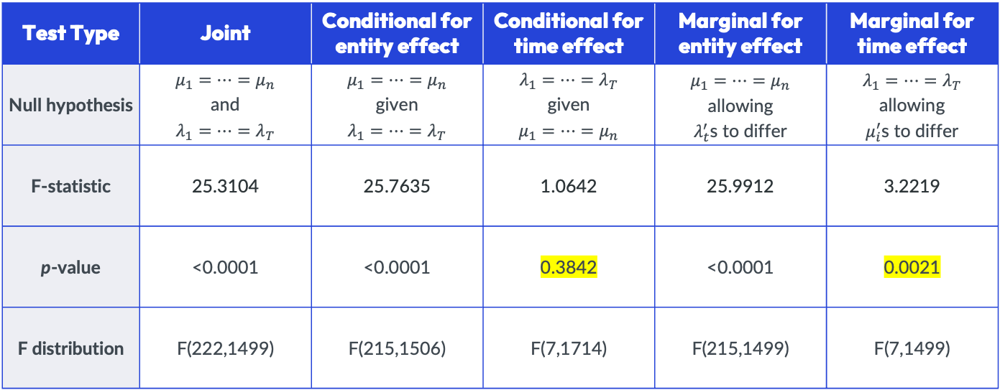
F-tests for Fixed Effects
Test Type | Joint | Conditional for entity effect | Conditional for time effect | Marginal for entity effect | Marginal for time effect
Null hypothesis | $$μ_{1}=⋯=μ_{n}$$ and $$λ_{1}=⋯=λ_{T}$$ | $$μ_{1}=⋯=μ_{n}$$ given $$λ_{1}=⋯=λ_{T}$$ | $$λ_{1}=⋯=λ_{T}$$ given $$μ_{1}=⋯=μ_{n}$$ | $$μ_{1}=⋯=μ_{n}$$ allowing $λ_{t}^{′}$s to differ | $$λ_{1}=⋯=λ_{T}$$ allowing $μ_{i}^{′}$s to differ
F-statistic | 25.3104 | 25.7635 | 1.0642 | 25.9912 | 3.2219
p-value | <0.0001 | <0.0001 | 0.3842 | <0.0001 | 0.0021
F distribution | F(222,1499) | F(215,1506) | F(7,1714) | F(215,1499) | F(7,1499)

Slide 24
Robust Estimation for FE
Estimation | F-statistic | P-value | Distribution
Non-robust | 79.286 | <0.0001 | F(6,1506)
Entity-cluster robust | 18.662 | <0.0001 | F(6,1506)
Time-cluster robust | 1708.8 | <0.0001 | F(6,1506)

Slide 25
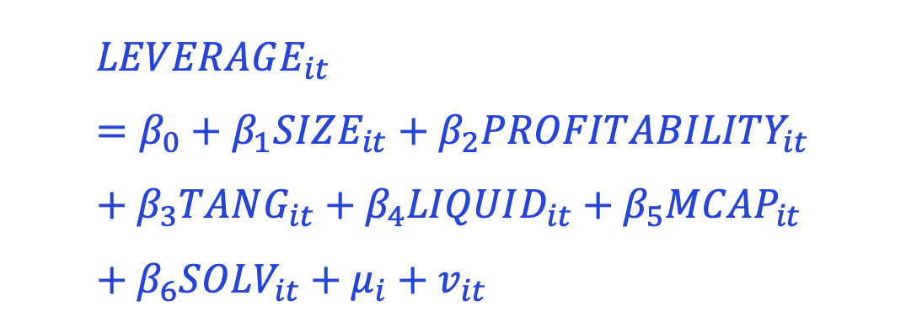
Fixed Effects Model with entity cluster
$$LEVERAGE_{it}=β_{0}+β_{1}SIZE_{it}+β_{2}PROFITABILITY_{it}+β_{3}TANG_{it}+β_{4}LIQUID_{it}+β_{5}MCAP_{it}+β_{6}SOLV_{it}+μ_{i}+v_{it}$$

Slide 26
Cluster Robust Entity Fixed Effects Model
PanelOLS Estimation Summary
================================================================================
Dep. Variable: LEVERAGE R-squared: 0.2401
Estimator: PanelOLS R-squared (Between): 0.1308
No. Observations: 1728 R-squared (Within): 0.2401
Date: Mon, Apr 01 2024 R-squared (Overall): 0.1504
Time: 13:05:53 Log-likelihood 1615.1
Cov. Estimator: Clustered
F-statistic: 79.286
Entities: 216 P-value 0.0000
Avg Obs: 8.0000 Distribution: F(6,1506)
Min Obs: 8.0000
Max Obs: 8.0000 F-statistic (robust): 18.662
P-value 0.0000
Time periods: 8 Distribution: F(6,1506)
Avg Obs: 216.00
Min Obs: 216.00
Max Obs: 216.00
Parameter Estimates
=================================================================================
Parameter Std. Err. T-stat P-value Lower CI Upper CI
---------------------------------------------------------------------------------
const -1.5595 0.4675 -3.3358 0.0009 -2.4765 -0.6425
SIZE 0.0834 0.0238 3.5041 0.0005 0.0367 0.1301
PROFITABILITY -0.2270 0.0543 -4.1783 0.0000 -0.3336 -0.1205
TANG 0.4346 0.0807 5.3864 0.0000 0.2763 0.5928
LIQUID -0.0228 0.0062 -3.6503 0.0003 -0.0350 -0.0105
MCAP -4.195e-12 3.294e-12 -1.2735 0.2030 -1.066e-11 2.266e-12
SOLV -0.0002 0.0001 -1.7470 0.0808 -0.0004 2.405e-05
=================================================================================
F-test for Poolability: 25.763
P-value: 0.0000
Distribution: F(215,1506)
Included effects: Entity

Slide 27
04
Test for Random Effects

Slide 28
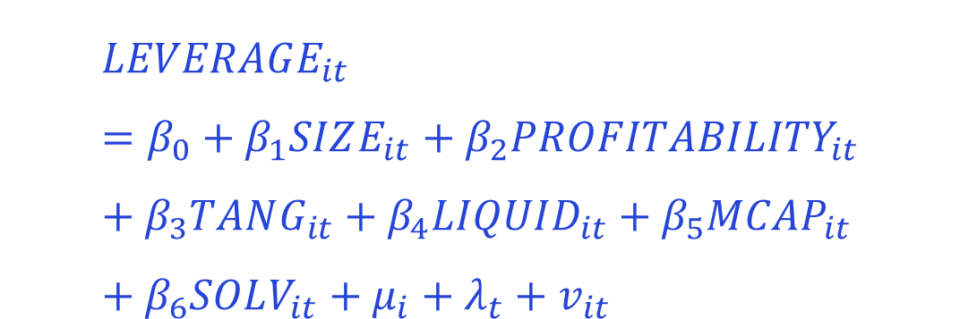
Random Effects Model
$$LEVERAGE_{it}=β_{0}+β_{1}SIZE_{it}+β_{2}PROFITABILITY_{it}+β_{3}TANG_{it}+β_{4}LIQUID_{it}+β_{5}MCAP_{it}+β_{6}SOLV_{it}+μ_{i}+λ_{t}+v_{it}$$

Slide 29
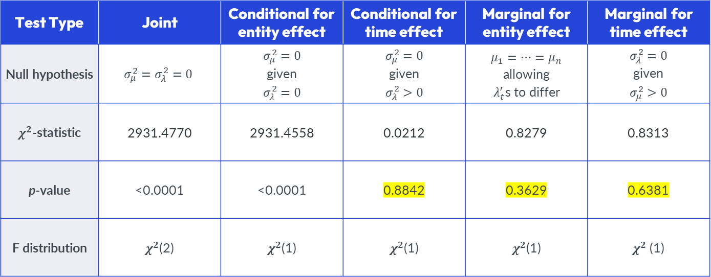
LM-tests for Random Effects
Test Type | Joint | Conditional for entity effect | Conditional for time effect | Marginal for entity effect | Marginal for time effect
Null hypothesis | $$σ_{μ}^{2}=σ_{λ}^{2}=0$$ | $$σ_{μ}^{2}=0$$ given $$σ_{λ}^{2}=0$$ | $$σ_{μ}^{2}=0$$ given $$σ_{λ}^{2}>0$$ | $$μ_{1}=⋯=μ_{n}$$ allowing $λ_{t}^{′}$s to differ | $$σ_{λ}^{2}=0$$ given $$σ_{μ}^{2}>0$$
$χ^{2}$-statistic | 2931.4770 | 2931.4558 | 0.0212 | 0.8279 | 0.8313
p-value | <0.0001 | <0.0001 | 0.8842 | 0.3629 | 0.6381
F distribution | $χ^{2}$(2) | $χ^{2}$(1) | $χ^{2}$(1) | $χ^{2}$(1) | $χ^{2}$(1)

Slide 30
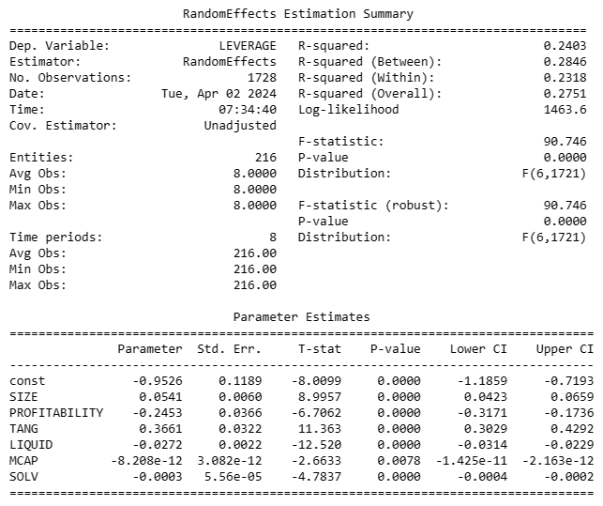


Entity Random Effects Model

Slide 31
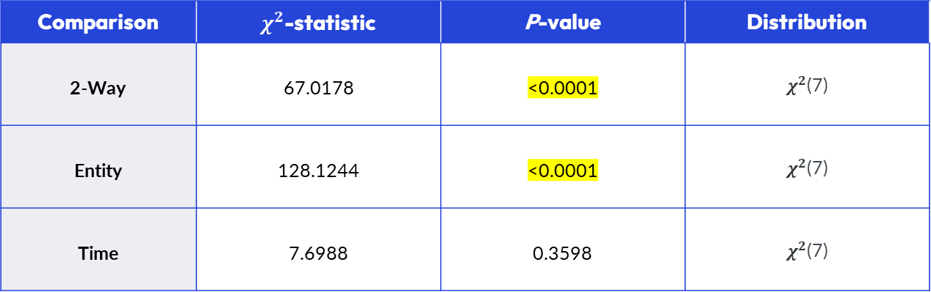
Hausman Test for Random Effects
Comparison | $χ^{2}$-statistic | P-value | Distribution
2-Way | 67.0178 | <0.0001 | $χ^{2}$(7)
Entity | 128.1244 | <0.0001 | $χ^{2}$(7)
Time | 7.6988 | 0.3598 | $χ^{2}$(7)

Slide 32
05
Test for Correlated Random Effects

Slide 33
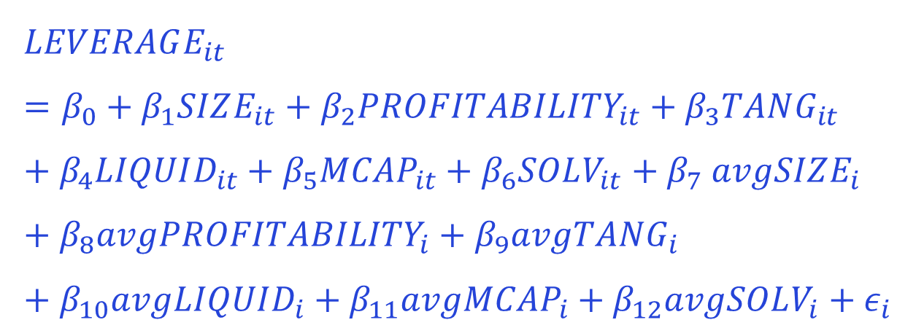
Correlated Random Effects Model
$$LEVERAGE_{it}=β_{0}+β_{1}SIZE_{it}+β_{2}PROFITABILITY_{it}+β_{3}TANG_{it}+β_{4}LIQUID_{it}+β_{5}MCAP_{it}+β_{6}SOLV_{it}{+ β}_{7}avgSIZE_{i}+β_{8}avgPROFITABILITY_{i}+β_{9}avgTANG_{i}+β_{10}avgLIQUID_{i}+β_{11}avgMCAP_{i}+β_{12}avgSOLV_{i}+ε_{i}$$

Slide 34
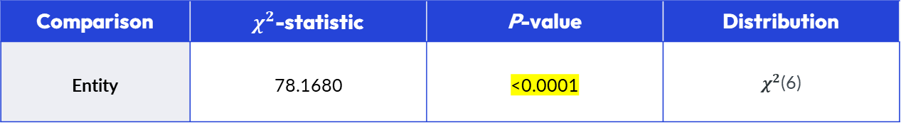
Wald-Test for Correlated Random Effects
Comparison | $χ^{2}$-statistic | P-value | Distribution
Entity | 78.1680 | <0.0001 | $χ^{2}$(6)

Slide 35
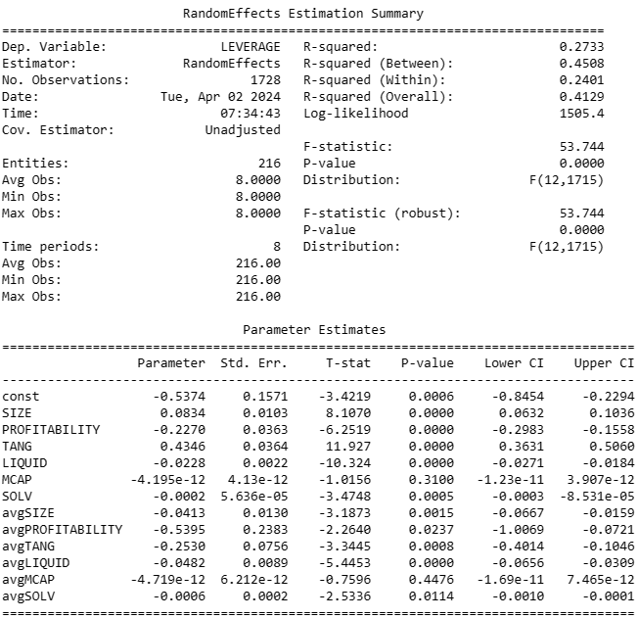




Entity Correlated Random Effects Model

Slide 36
Robust methods of CRE model
Estimation | F-statistic | P-value | Distribution
Non-robust | 53.744 | <0.0001 | F(12, 1715)
Entity-cluster robust | 36.989 | <0.0001 | F(12, 1715)

Slide 37
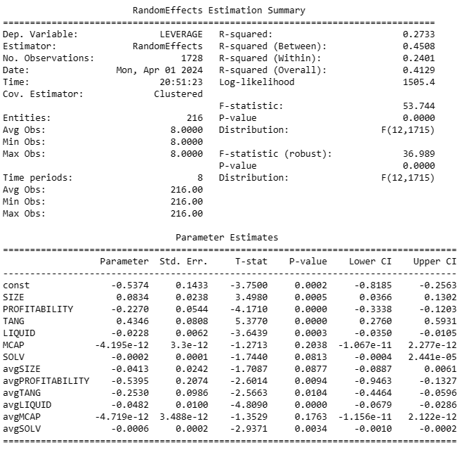


Robust Correlated Random Effects Model

Slide 38
Interpretations of the model
Parameter | Relationship | Explanation
Size | Positive | Larger companies rely more heavily on debt financing likely because they have the means to do so.
Profitability | Negative | More profitable companies have stronger internal financing capabilities and thus, will rely upon debt less.
Tangibility | Positive | Higher tangibility provides larger collateral for loans, which makes debt financing relatively accessible and cheaper compared to more intangible companies.
Liquidity | Negative | Likely a correlation indicator, as firms that rely less upon short-term debt financing will naturally have higher liquidity.
Solvency | Negative | Likely a correlation indicator, as firms that rely less upon debt financing will naturally have stronger interest coverage ratios.
Time-Invariant Effects | Negative | It appears that SGX listed firms are likely to have firm leverage ratio targets/policies resistant to economic changes.

Slide 39
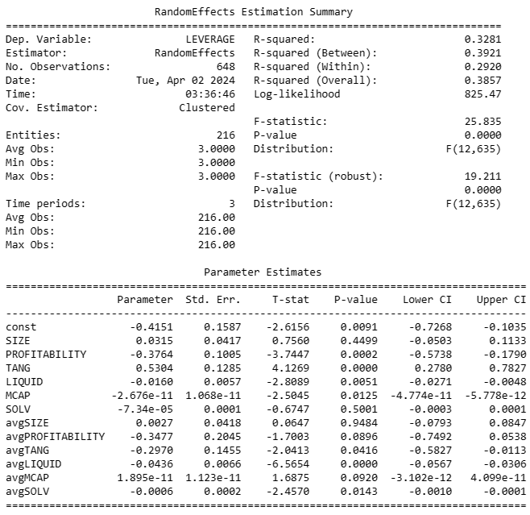
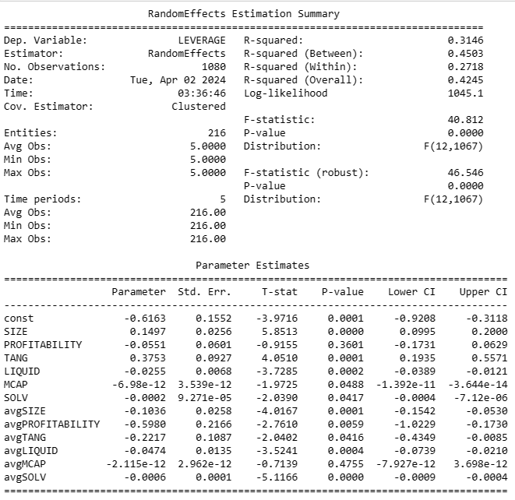
COVID Differences
COVID
Normal

Slide 40
Interpretations of the model
Parameter | Δ Significance | Explanation
Size | Insignificant | During the COVID period, everyone was equally affected and larger firms were increasingly reliant on debt financing as well.
Profitability | Significant | During the COVID period, firms that were profitable could choose to rely less upon debt, whereas, profitability did not give a clear indication of the firm’s leverage structure.
Solvency | Insignificant | Likely due to widespread impact on the market outlook and increasing reliance upon debt, interest coverage ratio could no longer be associated with lower leverage structures.
Time-Invariant Size | Insignificant | Like with the size parameter, firm’s debt reliance behaviour no longer depended upon its size as most firms needed to increase debt financing reliance regardless. It thus, became impossible to observe the firm-specific effects on the model during this period.

Slide 41
Thank You.

